Slide 1
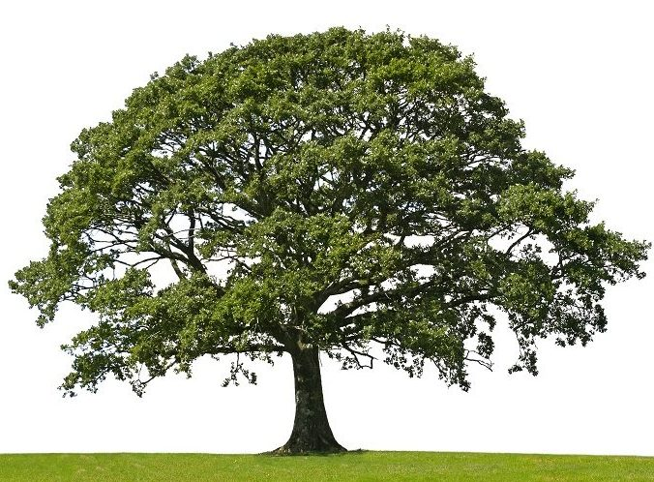
Random Forests
Roel van der Ploeg (g.r.ploeg@uva.nl) – 24/01/2025

Slide 2
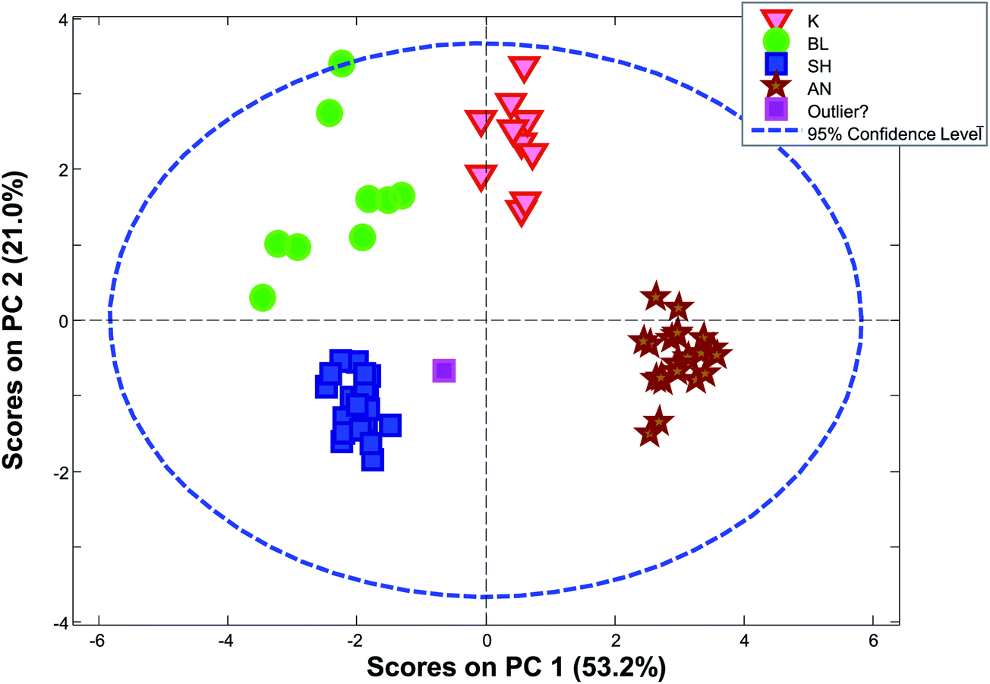
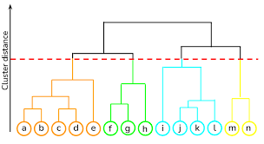
Methods
Exploration (X)
PCA
Clustering
Y information is not used in calculations, but only to color samples
Supervised analysis
Use Y to calculate model (Y = Xb + E)
Classification: Y defines groups
High dimensional ANOVA: Y defines experimental design information
Regression: Y defines quantitative information
Machine learning for nonlinear models
Random Forest
Neural Nets
Validation:
Test whether model does not overfit / effects are different from zero
Variable (metabolites / genes)
Response (Y)
Data (X)
Samples
Univariate analysis (Gene expression data)
Comparability
Error structure
Multivariate data analysis methods
Gene expression and metabolomics data
Microbiome data
Sparse and compositional data requires specific multivariate data analysis tools based on between sample distances

Slide 3
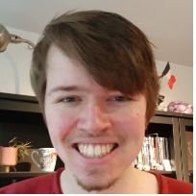
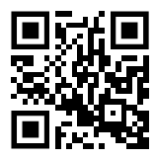
About me
Bachelor Medical Natural Sciences
Master Bioinformatics and Systems Biology
Internship 1: Mapping of logical models to experimental data reveals potential mechanisms behind epistatic inversion (@VU)
Internship 2: Investigation of structural variant detection in colorectal cancer using Pacific Biosciences circular consensus sequencing long read data (@NKI)
PhD at Biosystems Data Analysis group
Topic: multi-omics data integration
www.grvanderploeg.com

Slide 4
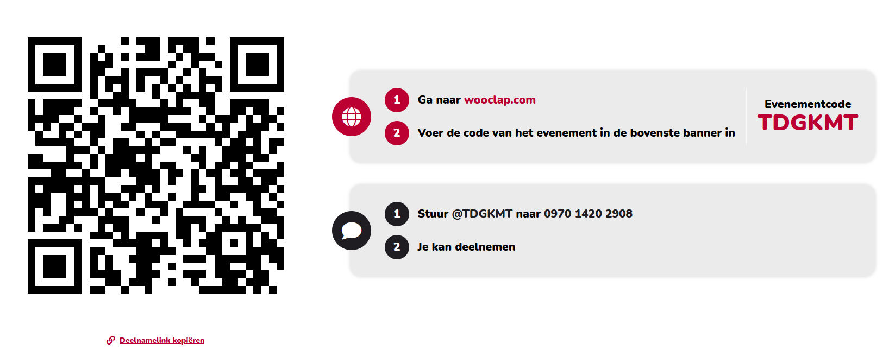

Slide 5


Slide 6
Contents
Machine learning in a nutshell
Decision trees
Regression
Classification
Aggregation methods: bagging
Random Forests

Slide 7
Aims for this lecture
You understand how decision tree models work algorithmically.
You know how bagging works algorithmically.
You know how random forests work algorithmically.
You understand how (aggregated) decision trees work in the context of regression and classification tasks.
You can assess the validity of an (aggregated) decision tree model.
You know some relevant hyperparameters that can be set for an (aggregated) decision tree model.

Slide 8
Contents
Machine learning in a nutshell
Decision trees
Regression
Classification
Aggregation methods: bagging
Random Forests

Slide 9
Machine learning in a nutshell: definitions
Features
Response variable Y
X
Y
Samples

Slide 10
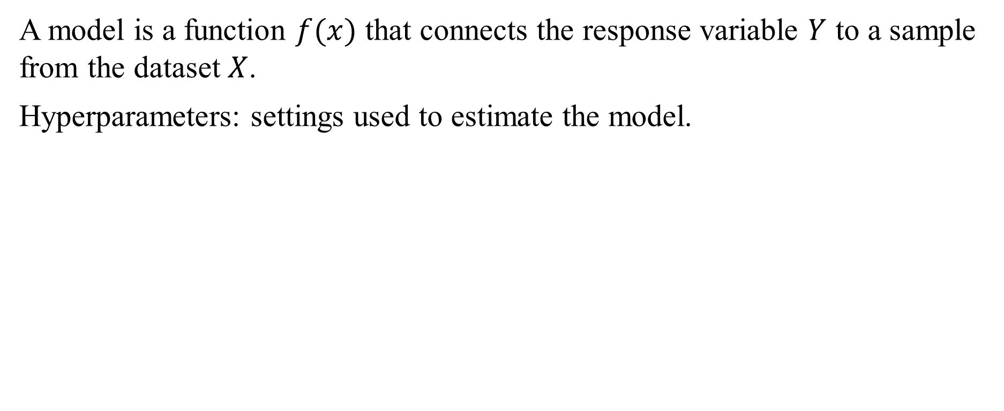
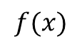
Machine learning in a nutshell: model
A model is a function $f(x)$ that connects the response variable $Y$ to a sample from the dataset $X$.
Hyperparameters: settings used to estimate the model.
X
Y
$$f(x)$$
Model
Notes:
Hyper parameters are settings used to estimate the model (such that is it close to the model you would like to have, the number of possible models is huge

Slide 11
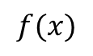
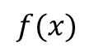
Machine learning in a nutshell: tasks
Regression
Classification
Y
Y
X
21
X
Healthy
35
Diseased
$$f(x)$$
42
$$f(x)$$
Healthy
31
Healthy
55
Diseased
60
Diseased
49
Diseased

Slide 12
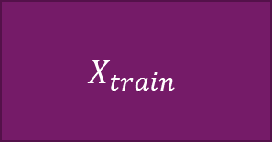
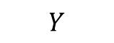
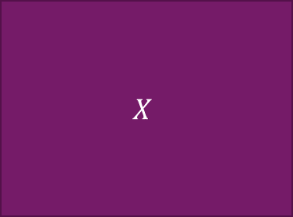
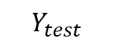
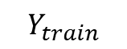
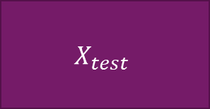
Machine learning in a nutshell: train and test data
$$Y_{train}$$
$$X_{train}$$
$$Y$$
$$X$$
$$Y_{test}$$
$$X_{test}$$

Slide 13

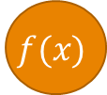

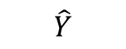
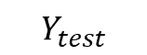
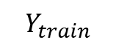
Machine learning in a nutshell: validation
$$Y_{train}$$
$$X_{train}$$
Model training
Hyperparameter settings
$$f(x)$$
$$\hat{Y}$$
Model testing
Model evaluation
$$Y_{test}$$
$$X_{test}$$
Loss function selection

Slide 14
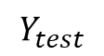
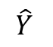
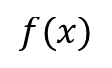
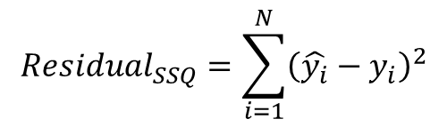
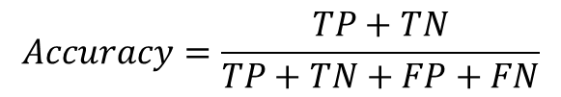
Machine learning in a nutshell: loss
A loss function describes model performance by comparing the predicted response with the real response.
$$\hat{Y}$$
$$Y_{test}$$
$$Accuracy=\frac{TP+TN}{TP+TN+FP+FN}$$
Test dataset
Healthy
Diseased
Diseased
Diseased
Healthy
Healthy
$$Residual_{SSQ}=\sum_{i=1}^{N}{{\left(\hat{y_{i}}−y_{i}\right)}^{2}}$$
$$f(x)$$
Healthy
Healthy
Diseased
Diseased
Healthy
Diseased
 |  | True class
 |  | Healthy | Diseased
Predicted class | Healthy | 2 | 2
 | Diseased | 0 | 3
Diseased
Diseased

Slide 15
Contents
Machine learning in a nutshell
Decision trees
Regression
Classification
Aggregation methods: bagging
Random Forests

Slide 16
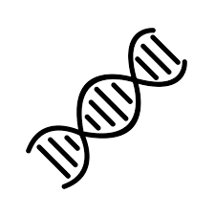

There’s been a murder!
Naue, J., et al. (2017). Chronological age prediction based on DNA methylation: Massive parallel sequencing and random forest regression. Forensic Science International: Genetics, 31, 19–28. https://doi.org/10.1016/j.fsigen.2017.07.015

Slide 17
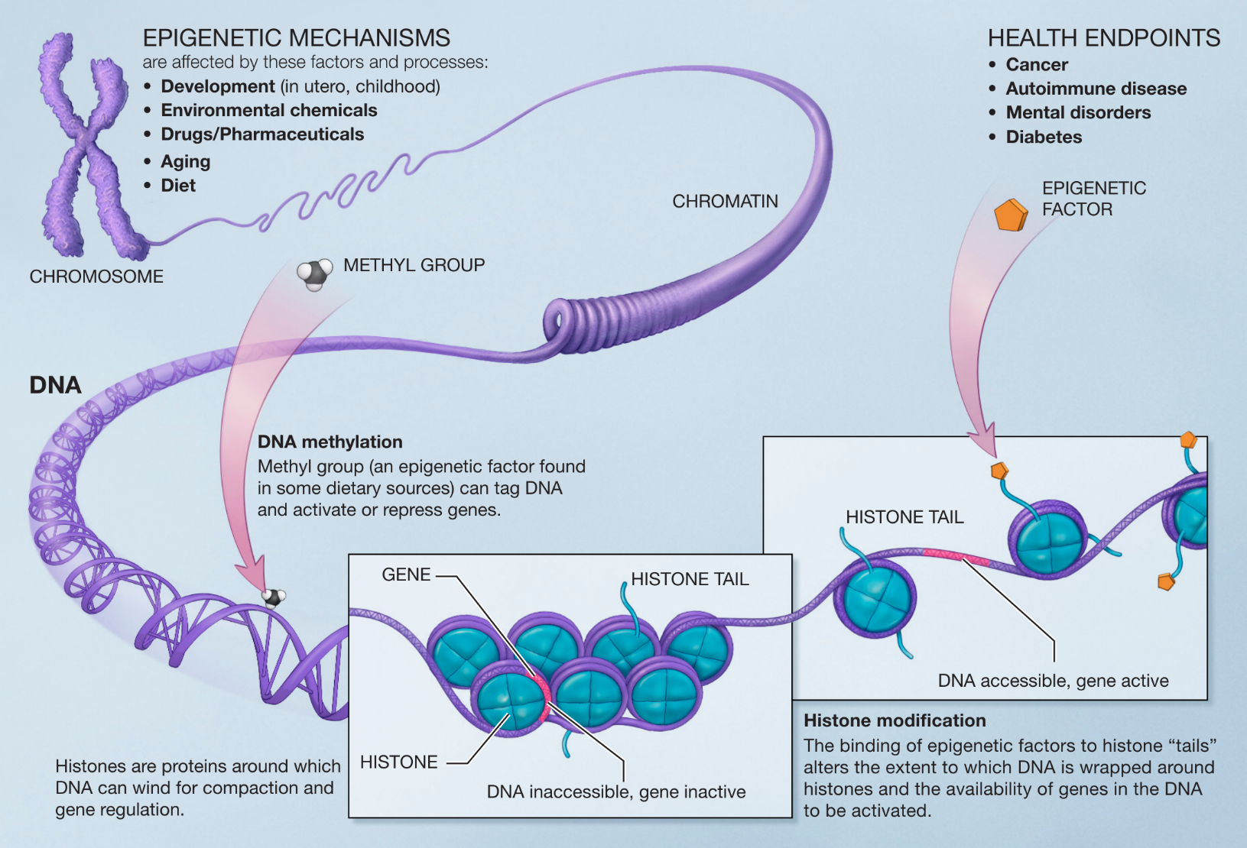
CpG sites
CpG methylation is an epigenetic marker
It can either activate or repress genes
CpG methylation is different per tissue/body fluid
Some sites have been found to be indicative of age (see literature below)
Horvath, S. (2013). DNA methylation age of human tissues and cell types. Genome Biology, 14(10), R115. https://doi.org/10.1186/gb-2013-14-10-r115
Hannum, G., et al. (2013). Genome-wide Methylation Profiles Reveal Quantitative Views of Human Aging Rates. Molecular Cell, 49(2), 359–367. https://doi.org/10.1016/j.molcel.2012.10.016
Bell, J. T., et al. (2012). Epigenome-Wide Scans Identify Differentially Methylated Regions for Age and Age-Related Phenotypes in a Healthy Ageing Population. PLoS Genetics, 8(4), e1002629. https://doi.org/10.1371/journal.pgen.1002629

Slide 18
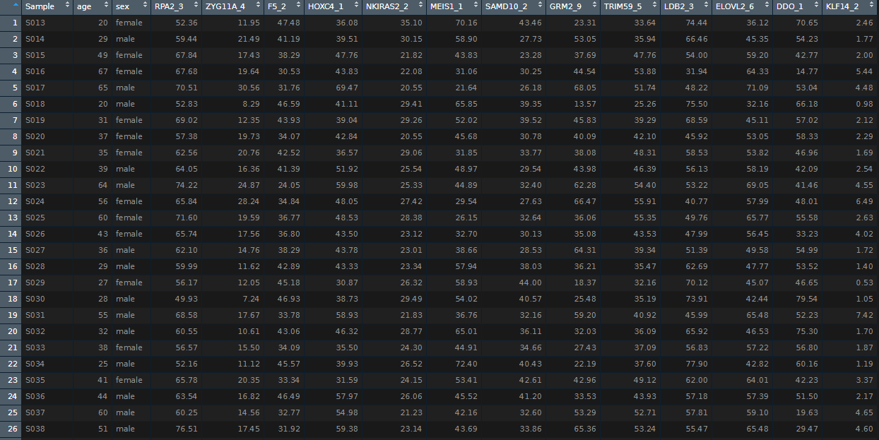
CpG dataset
13 CpG sites:
each value is the methylation percentage
Response variable Y
312 samples
Naue, J., et al. (2017). Chronological age prediction based on DNA methylation: Massive parallel sequencing and random forest regression. Forensic Science International: Genetics, 31, 19–28. https://doi.org/10.1016/j.fsigen.2017.07.015

Slide 19
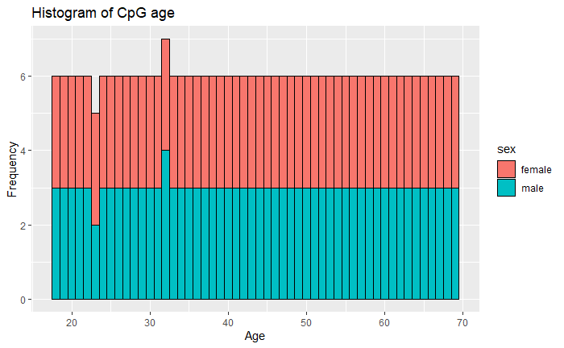
CpG dataset
The dataset is balanced
Minimum age: 18
Maximum age: 69

Slide 20
Notes:
Mean age: 43.5

Slide 21
Decision trees: the task (regression)
Create subdivisions of the multivariate data using thresholds until you can accurately predict the subpopulation.
In the case of our CpG regression problem: find thresholds to set in terms of CpG methylation percentage to accurately predict age.
CpG site
X
Average age: 20
< 50%
Average age: 60
> 50%
Threshold: CpG site methylation > 50%
Notes:
Clearly indicate subdivisions

Slide 22
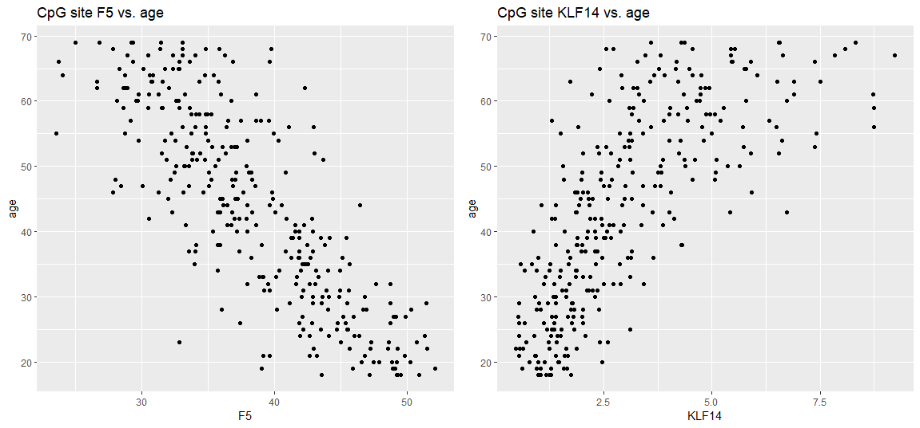
Let’s make a toy example using only two CpG sites:

Slide 23
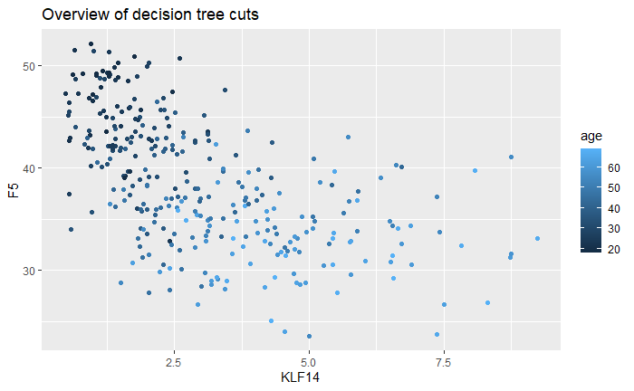
Regressing age on two variables
You need both F5 and KLF14 to predict age
Let’s say you can set one predictive threshold for one variable; where would it be?

Slide 24
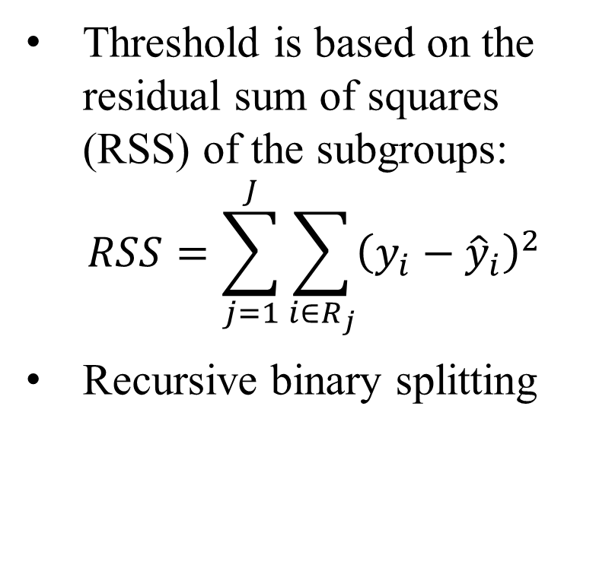
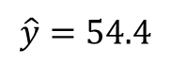
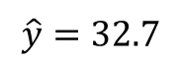
Finding the optimal split to make
Threshold is based on the residual sum of squares (RSS) of the subgroups:
$$RSS=\sum_{j=1}^{J}{\sum_{i∈R_{j}}{{\left(y_{i}−{\hat{y}}_{i}\right)}^{2}}}$$
Recursive binary splitting
$$\hat{y}=32.7$$
$$\hat{y}=54.4$$

Slide 25
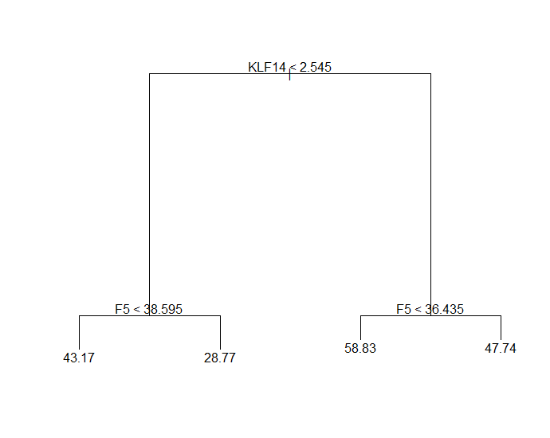
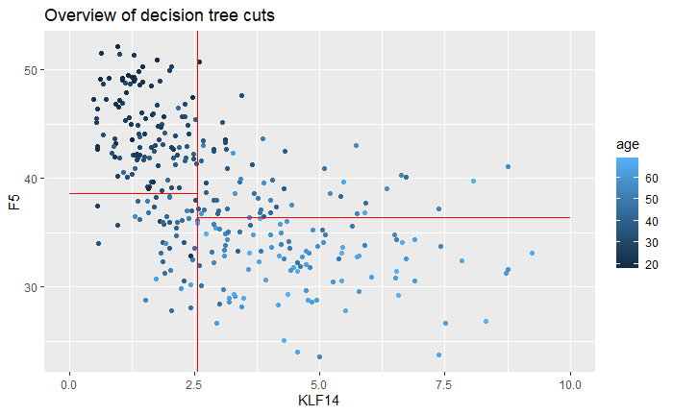
Decision tree result using two CpG sites
← Yes
No →
← Yes
No →
← Yes
No →
Notes:
Explain: split, leaf node, branch

Slide 26
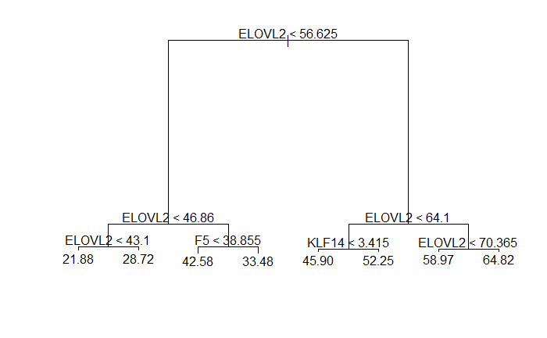
Using all CpG sites:

Slide 27
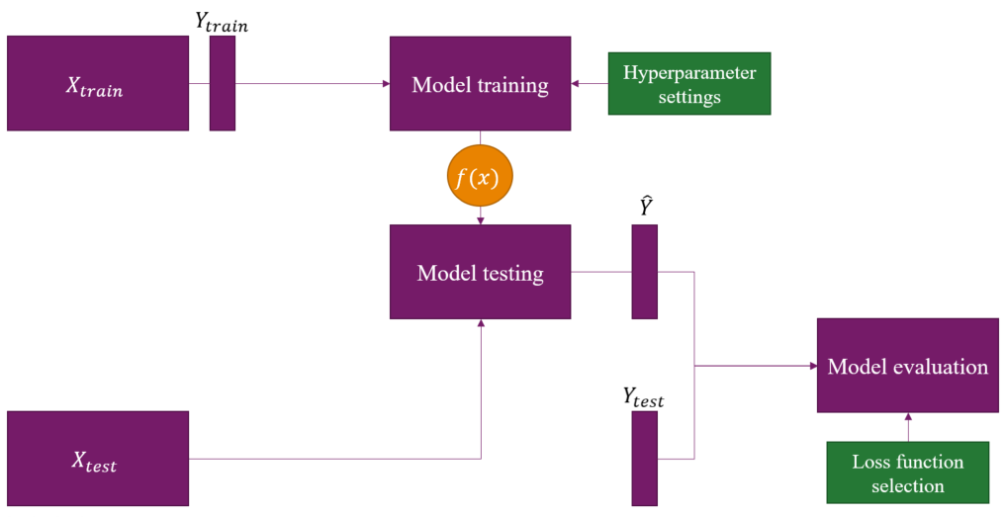
Where to evaluate your model performance

Slide 28
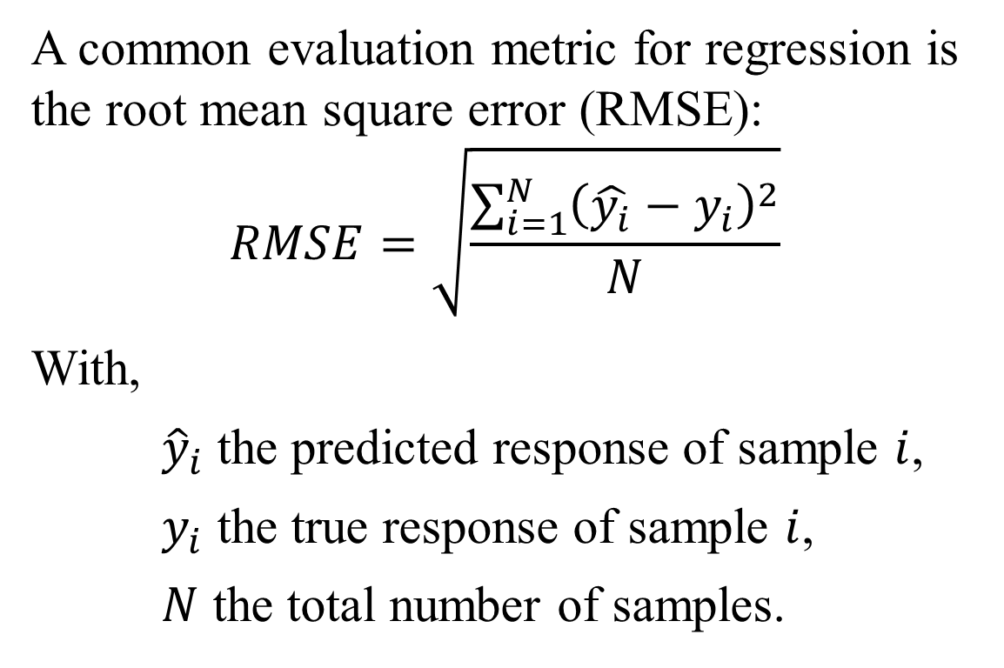
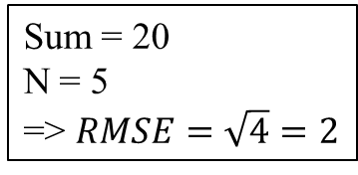
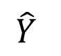
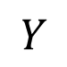
How to evaluate your decision tree (regression)
$$\hat{Y}$$
$$Y$$
A common evaluation metric for regression is the root mean square error (RMSE):
$$RMSE=\sqrt{\frac{\sum_{i=1}^{N}{{\left(\hat{y_{i}}−y_{i}\right)}^{2}}}{N}}$$
With,
${\hat{y}}_{i}$ the predicted response of sample $i$,
$y_{i}$ the true response of sample $i$,
$N$ the total number of samples.
19
18
1
18
19
-1
23
-
20
=
3
18
21
-3
22
22
0
2
1
1
2
(-1)
1
Sum = 20
N = 5
=> $RMSE=\sqrt{4}=2$
2
3
=
9
2
(-3)
9
2
0
0
Notes:
Today I will stick with RMSE

Slide 29
Some decision tree hyperparameters:
Number of leaf nodes
Tree depth
Minimum decrease in RMSE of a split

Slide 30
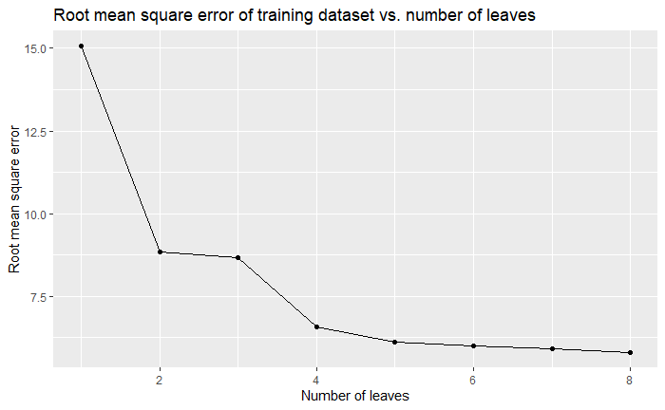
The effect of the number of leaves on training RMSE

Slide 31
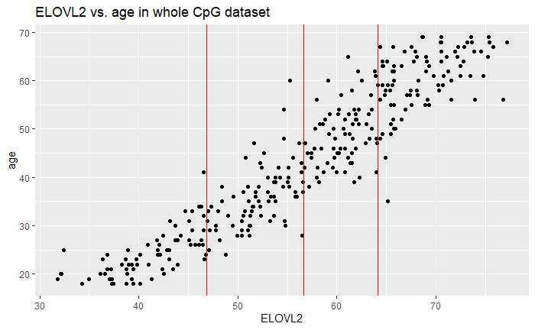
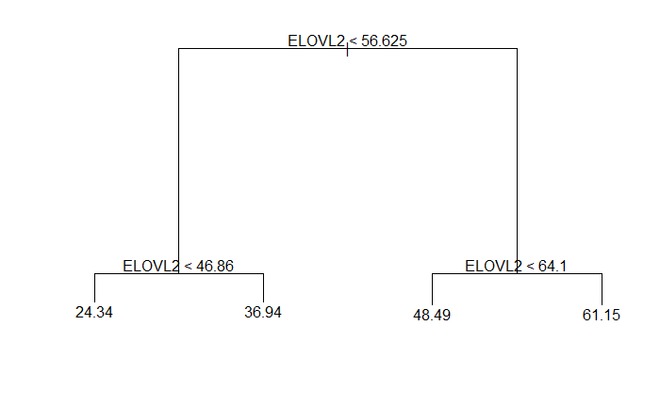
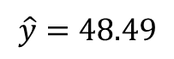
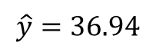
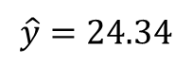
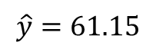
The best decision tree model?
$$\hat{y}=48.49$$
$$\hat{y}=61.15$$
$$\hat{y}=24.34$$
$$\hat{y}=36.94$$

Slide 32
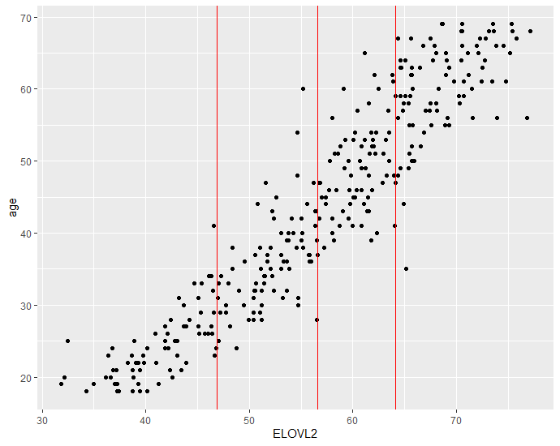




$$\hat{y}=36.94$$
$$\hat{y}=48.49$$
$$\hat{y}=24.34$$
$$\hat{y}=61.15$$

Slide 33
Let’s now consider the test set

Slide 34

Comparing the predicted age vs. real age
The “best” decision tree gets reasonably close
RMSE = 6.51
Why are there only four predicted age values?

Slide 35
We will keep track of our model performance here
CpG dataset
Method | RMSE
Normal decision tree | 6.51

Slide 36
Contents
Machine learning in a nutshell
Decision trees
Regression
Classification
Aggregation methods: bagging
Random Forests

Slide 37

Caldana expression data
145 samples of 8 conditions
15,047 genes

Slide 39
Decision trees: the task (classification)
Create subdivisions of the multivariate data until you can accurately predict the subpopulation.
In the case of our classification problem: find thresholds to set in terms of gene expression to accurately predict the condition of the plant sample.
Gene expression
X
Majority class:
21-D
< 2
Majority class:
21-HL
> 2
Threshold: gene expression > 2

Slide 40

Let’s make another toy example with just two genes
Notes:
Again, a toy example using only two genes

Slide 41


Accuracy in a two-class problem
The “normal” accuracy metric you know is based on a two-class problem (positive vs. negative)
$$Accuracy=\frac{TP+TN}{TP+TN+FP+FN}=\frac{TP+TN}{N}$$
With,
$TP$ the true positives,
$TN$ the true negatives,
$FP$ the false positives,
$FN$ the false negatives,
$N$ the number of samples.
Real class
 | Positive | Negative
Positive | 49 | 2
Negative | 1 | 48
Predicted class
$$Accuracy=\frac{49+48}{49+48+2+1}=\frac{49+48}{100}=0.97$$
Notes:
Basically just the number of correct predictions divided over all the samples

Slide 42




Accuracy in a multi-class problem
Accuracy in a multi-class problem iterates over all of the classes:
$$Accuracy_{multi}=\sum_{iεC}^{C}{\frac{N_{correct}}{N_{samples}}}$$
With,
$C$ the set of classes in the dataset,
$N_{correct}$ the number of samples correctly predicted as class $i$,
$N_{samples}$ the number of samples in the dataset.
Real class
 | Class A | Class B | Class C
Class A | 99 | 2 | 28
Class B | 1 | 98 | 11
Class C | 0 | 0 | 61
Predicted class
$$Accuracy_{A}=\frac{99}{300}=0.33$$
$$Accuracy_{B}=\frac{98}{300}=0.327$$
$$Accuracy_{C}=\frac{61}{300}=0.203$$
$$⇒Accuracy_{multi}=0.33+0.327+0.203=0.86$$
Notes:
What is the minimum value?
What is the maximum value?

Slide 43




Finding the optimal split to make
Create subdivisions of the data that maximizes the multi-class accuracy:
$$Accuracy_{multi}=\sum_{iεC}^{C}{\frac{N_{correct}}{N_{samples}}}$$
Recursive binary splitting
$$\hat{y}=\text{21−}\text{L}$$
$$\hat{y}=\text{32−}\text{D}$$

Slide 44


The best model using only these two genes
4-L
4-D
21-D
32-D
21-HL
21-L
32-L
21-D
21-LL

Slide 45

Using all genes:
Notes:
Again, is this overfitted?

Slide 46

The effect of the number of leaves on the accuracy in the training data

Slide 47


The best decision tree?
Confusion table using the test set:
$$Accuracy_{multi}=0.8649$$

Slide 48
We will keep track of our model performance
CpG dataset
Caldana expression dataset
Method | RMSE
Normal decision tree | 6.51
Method | Multi-class accuracy
Normal decision tree | 0.8649

Slide 49
Pros and cons of decision trees
Pros:
Simple to understand and interpret
Can handle both numerical and class data
They require little data preparation
Cons:
Trees can be unstable
Learning is greedy
Prone to overfitting

Slide 50
Contents
Machine learning in a nutshell
Decision trees
Regression
Classification
Aggregation methods: bagging
Random Forests

Slide 51




Model aggregation
Model 1
$$\hat{y}$$
Sometimes you may want to model your data in various ways simultaneously
Each of your models can focus on a different aspect of the data
You can combine different models using aggregation
Model 2
$$\hat{y}$$
X
Integrate responses
Model 3
$$\hat{y}$$
Model 4
$$\hat{y}$$

Slide 52
Bagging
Split data into parts
Give each mini tree a part
Every tree sees only some samples
Every tree sees all variables
Majority voting
Caldana condition?
21-L
21-L
32-L
4-L
Majority vote: 21-L

Slide 53
Bagging procedure
X
Notes:
Note: no test set needed!

Slide 54

Why aggregating many trees helps model performance
Bagging makes the prediction more reliable
Bagging reduces the greediness of the algorithm
Bagging makes the model less prone to overfit
Notes:
You are better defended against high variance (if you split your data into two parts before modelling, you will get two different trees with different answers)
You can reduce the greediness of the algorithm: when there is one super strong predictor and several medium strength predictors, the super strong one is always chosen

Slide 55
A handy thing about bagging:
Out-of-bag
You can evaluate your model using out-of-bag samples!
Notes:
Note: no test set needed!

Slide 56
Bagging hyperparameters
Number of trees
The regular DL hyperparameters:
Number of leaf nodes
Tree depth
Minimum improvement in a split

Slide 58

Bagging evaluation options
Model performance (RMSE or Multi-class accuracy):
Using train set data
Using out-of-bag data
Using test set data
Feature importance
Notes:
OOB important to explain

Slide 59



Bagged classification
Out-of-bag confusion matrix:
Multi-class accuracy based on out-of-bag samples: 0.944
Test set confusion matrix:
Multi-class accuracy based on test data: 0.892

Slide 60

Feature importance
Mean decrease in accuracy: how much more poorly does the model do without the feature
Uses all splits in all bagged trees

Slide 61
Bagged regression
Similar to classification, but take the mean of all tree predictions
Age?
21.3
40.1
25.8
25.4
30.5
Majority vote is the mean: 28.62

Slide 62


Bagged results for CpG data
RMSE = 4.13

Slide 63
How much have we improved with bagging our trees?
CpG dataset
Caldana expression dataset
Method | RMSE
Normal decision tree | 6.51
Bagging | 4.13
Method | Multi-class accuracy
Normal decision tree | 0.865
Bagging | 0.892

Slide 65

A problematic bagged model?

Slide 66
Another problematic bagged model?
…

Slide 67
Can bagging overfit?
Yes, but it reduces the chances to overfit by splitting up the data.
If you take stupid hyperparameter settings, you can still overfit

Slide 68
Contents
Machine learning in a nutshell
Decision trees
Regression
Classification
Aggregation methods: bagging
Random Forests

Slide 69
Random Forests (RFs): the idea
Split data into parts
Give each tree a part:
Every tree sees only some samples
Every tree sees only some variables
Majority voting
Caldana condition?
21-L
21-L
32-L
4-L
Majority vote: 21-L
Notes:
Bagging, but then better:
Bagging is a special case of RF with m=p
Giving only some features per tree decorrelates the bagged trees

Slide 70
Random Forest procedure
X

Slide 71

Random Forest hyperparameters
Number of trees
Number of variables to give to each tree
Number of samples to give to each tree
Maximum number of leaves per tree
Maximum depth per tree
…many more!

Slide 72


Random Forest: performance on Caldana
Confusion table of the test set:
Multi-class accuracy: 0.973

Slide 73

Random Forest: feature importance on Caldana
You have now decorrelated your trees
There is now a different gene at the top

Slide 74


Random Forest: performance on CpG
RMSE: 3.99

Slide 75
How much have we improved using random forests?
CpG dataset
Caldana expression dataset
Method | RMSE
Normal decision tree | 6.51
Bagging | 4.13
Random forest | 3.99
Method | Multi-class accuracy
Normal decision tree | 0.865
Bagging | 0.892
Random forest | 0.973

Slide 76
Random Forest pros and cons
Pros:
Can handle both numerical and class data
They require little data preparation
Better protected against overfitting than decision trees
Better performance than decision trees
Cons:
Not easily interpretable:
You cannot see individual trees
You can only evaluate using aggregated statistics

Slide 77
Did we reach the aims for this lecture?
You understand how decision tree models work algorithmically.
You know how bagging works algorithmically.
You know how random forests work algorithmically.
You understand how (aggregated) decision trees work in the context of regression and classification tasks.
You can assess the validity of an (aggregated) decision tree model.
You know some relevant hyperparameters that can be set for an (aggregated) decision tree model.

Slide 78

Questions?
Notes:
And thank you for attending! Are there any questions?

